Slide 1





HUST 20221
SENSITIVE READING CONTENTS DETECTION
IT4142E - INTRODUCTION TO DATA SCIENCE
Tran Bao Chi - Nguyen Thanh Dat - Do Hoang Long
Hoang Tran Nhat Minh - Nguyen Truong Truong An

Slide 2

Project Description
Key Reason
Our project helps keep users, especially children from inappropriate contents when learning English from online contents.
Dataset
Crawled from multiple articles, websites, social media platforms and annotated sensitive labels.
Model
CRF, RNN-based, Transformer-based
Evaluation
Offline evaluation

Slide 3








Data Gathering Phases
01
02
03
04
Data Crawling
Data Processing
Data Storage
Annotating
Scrapy
Python
Doccano
MongoDB
Selenium
NLP Spark
JS Splash
Fast API

Slide 4
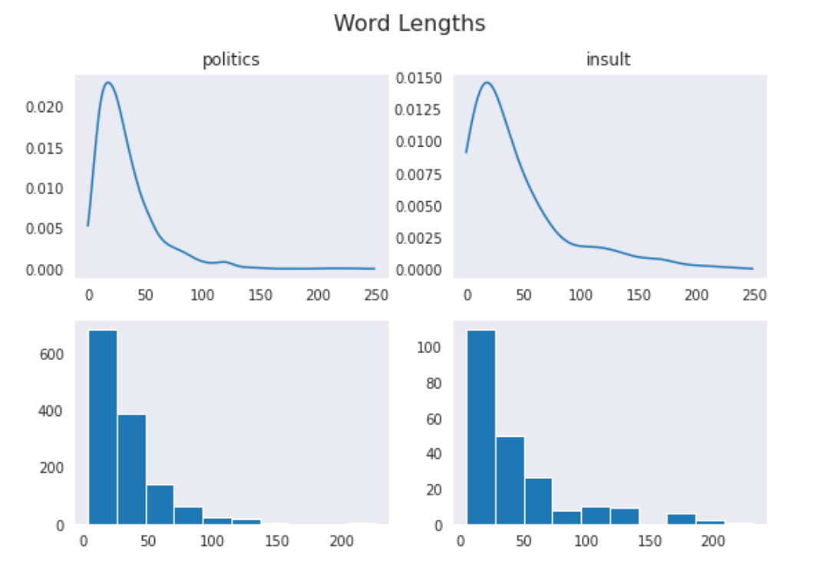
Sentence Length Frequency

Slide 5
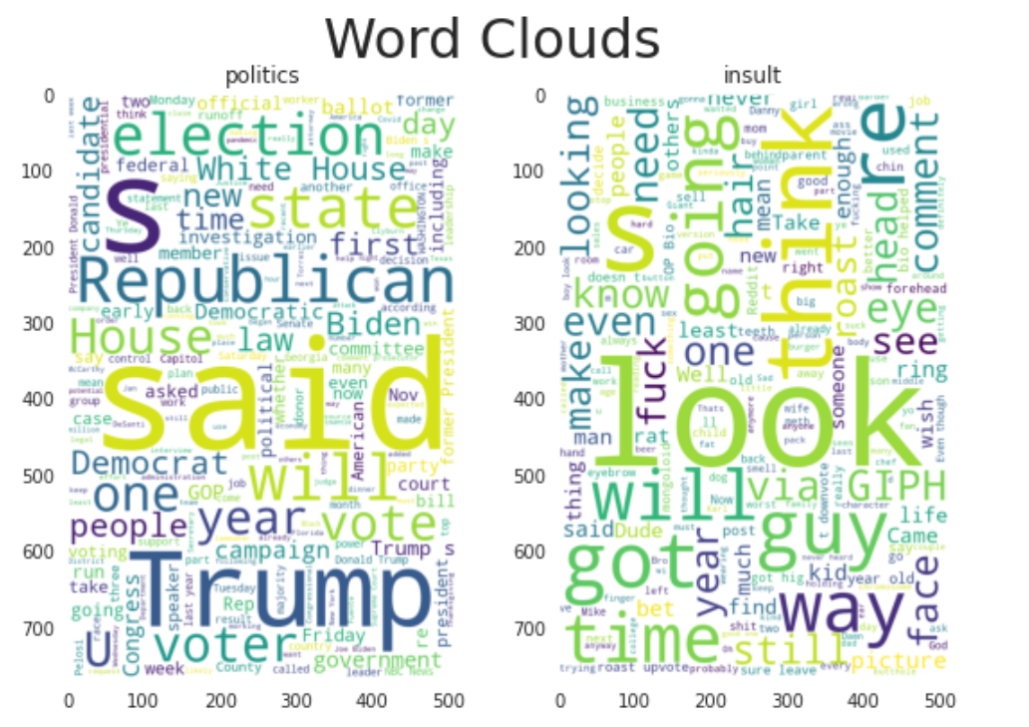
Word Frequency
Word Cloud

Slide 6
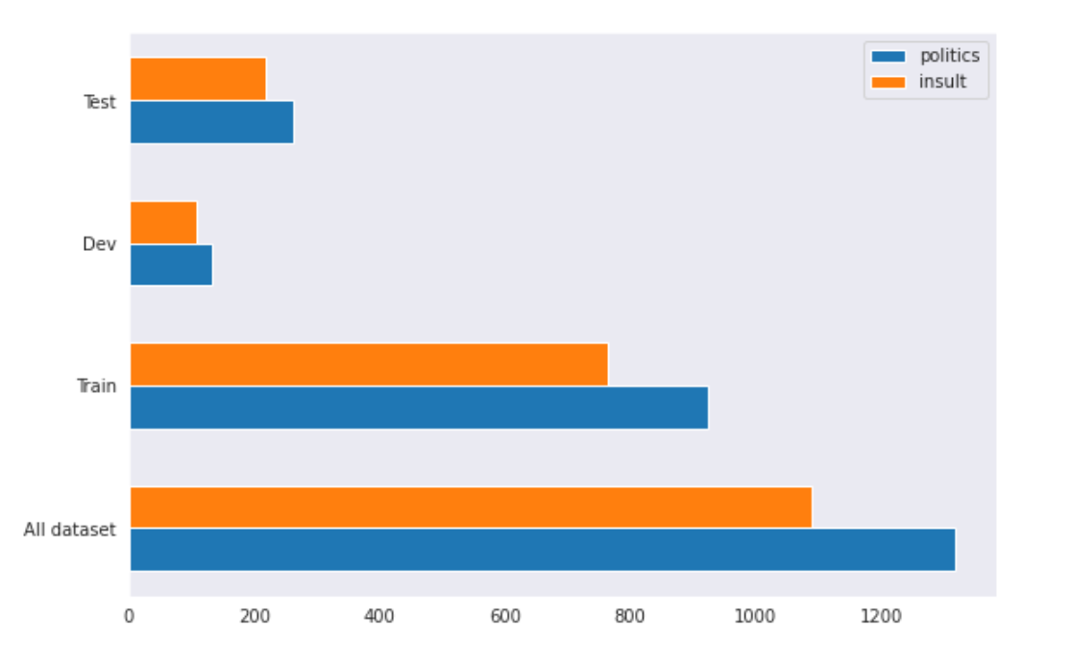
Dataset Split
Hold-out split

Slide 7
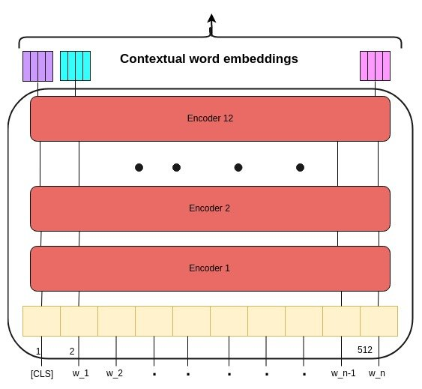
Manifold learning
Language model: BERT
Extracted embedding: 768-dimensional vector
Application: Fine-tuning on downstream tasks

Slide 8
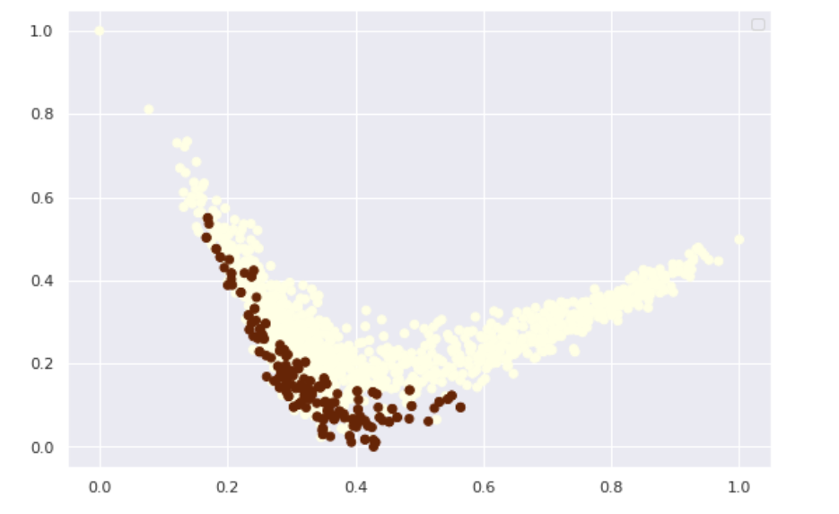
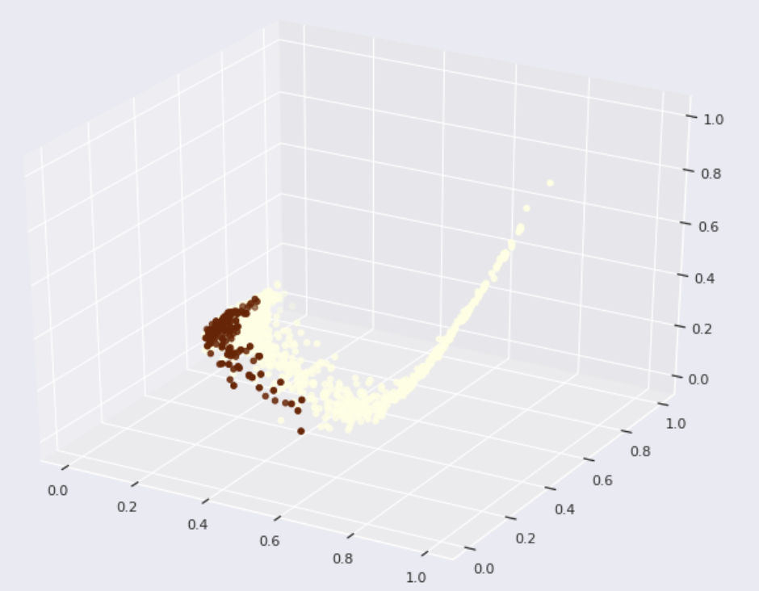
PCA: global structure
2D
3D

Slide 9
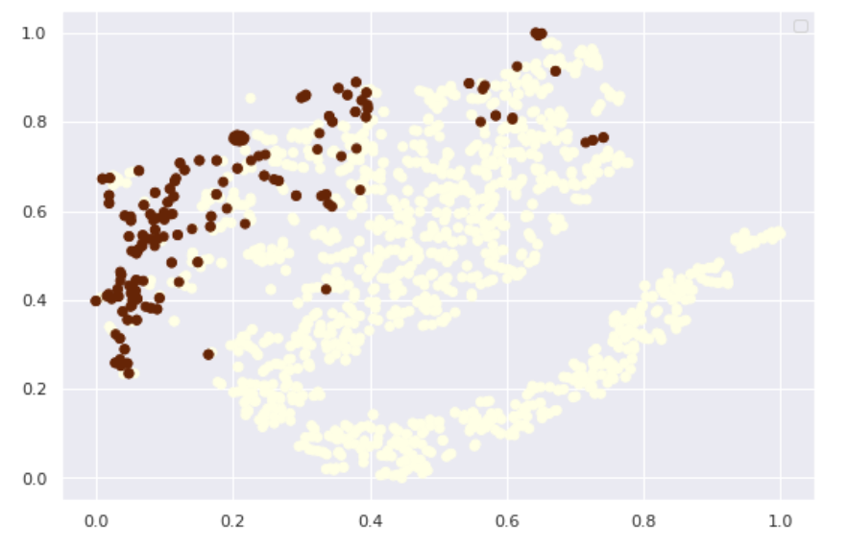
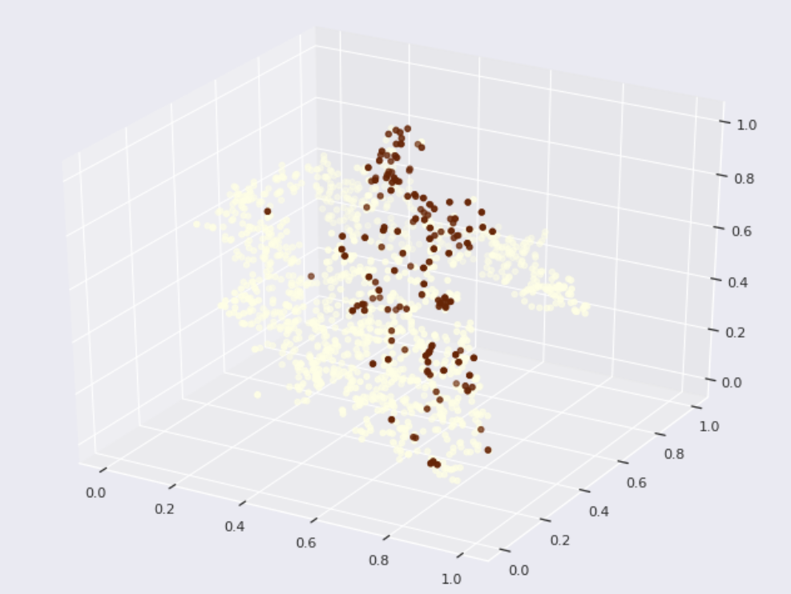
t-SNE: local structure
2D
3D

Slide 10
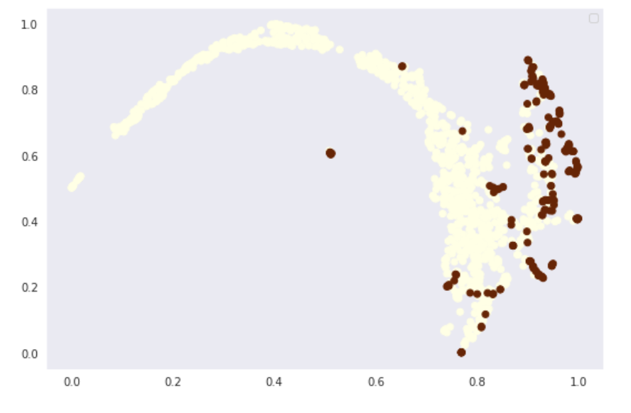
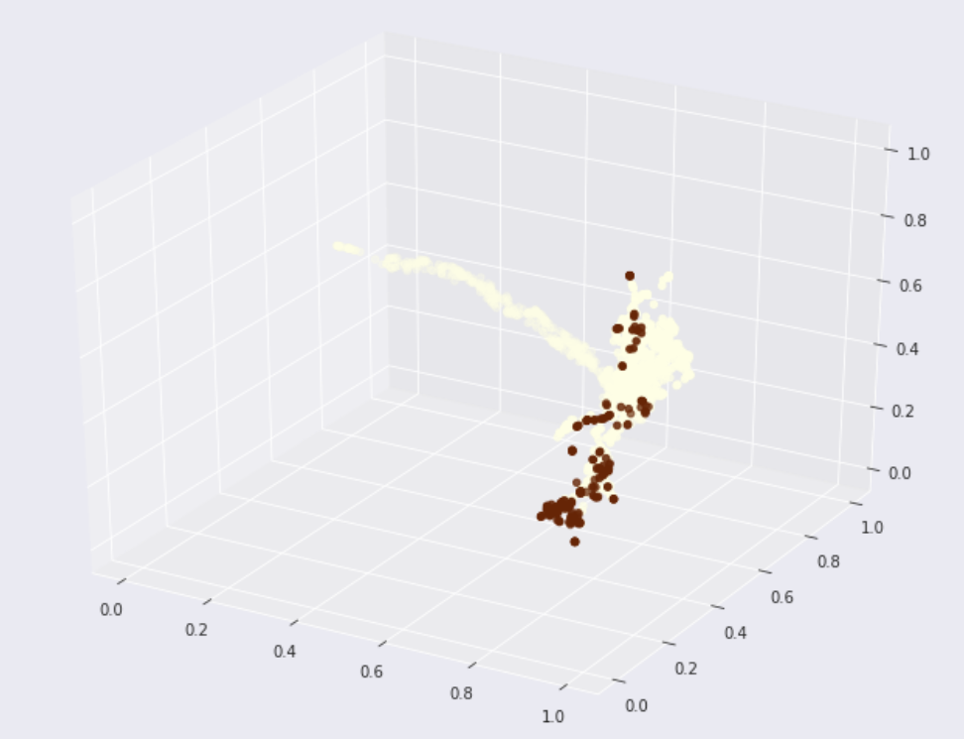
UMAP: global + local structure
2D
3D

Slide 11


THANK YOU
Do you have any questions for us?

